Slide 1

Contract Management Processes
INS4821 Construction Management
Prof. Dr. Zeynep IŞIK

Slide 2
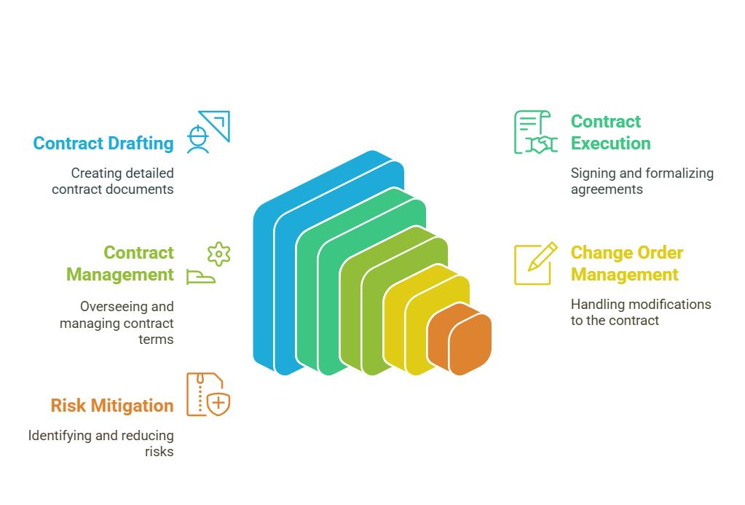
Contract Management Processes
  Pre-contract (Feasibility)
  Tendering & Bidding
  Contract Drafting
  Contract Negotiation and Finalization
  Contract Award and Signing
  Contract Administration and Monitoring

Slide 3
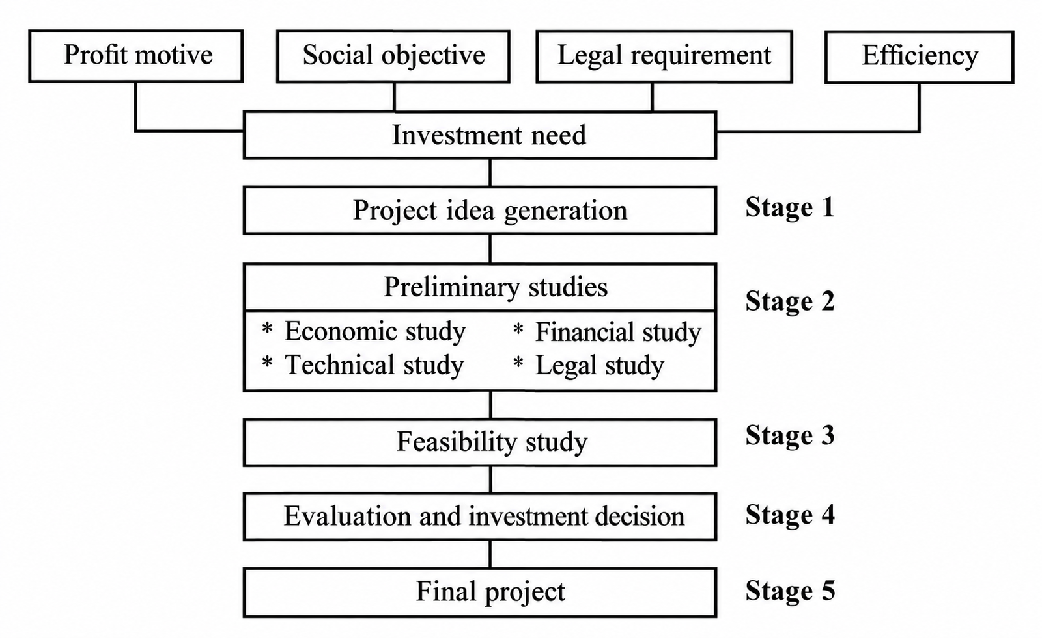
1-Pre-contract (Feasibility)
Feasibility (Appllicability)
It is a study that analyzes an investment—initially conceived as an idea—from sectoral, technical, and economic perspectives, in order to reach a decision on whether to proceed with its implementation.
Following the feasibility analysis—which determines that the project is technically, economically, and financially viable—and the subsequent investment decision, the tender process for the implementation of the project is initiated.

Slide 4
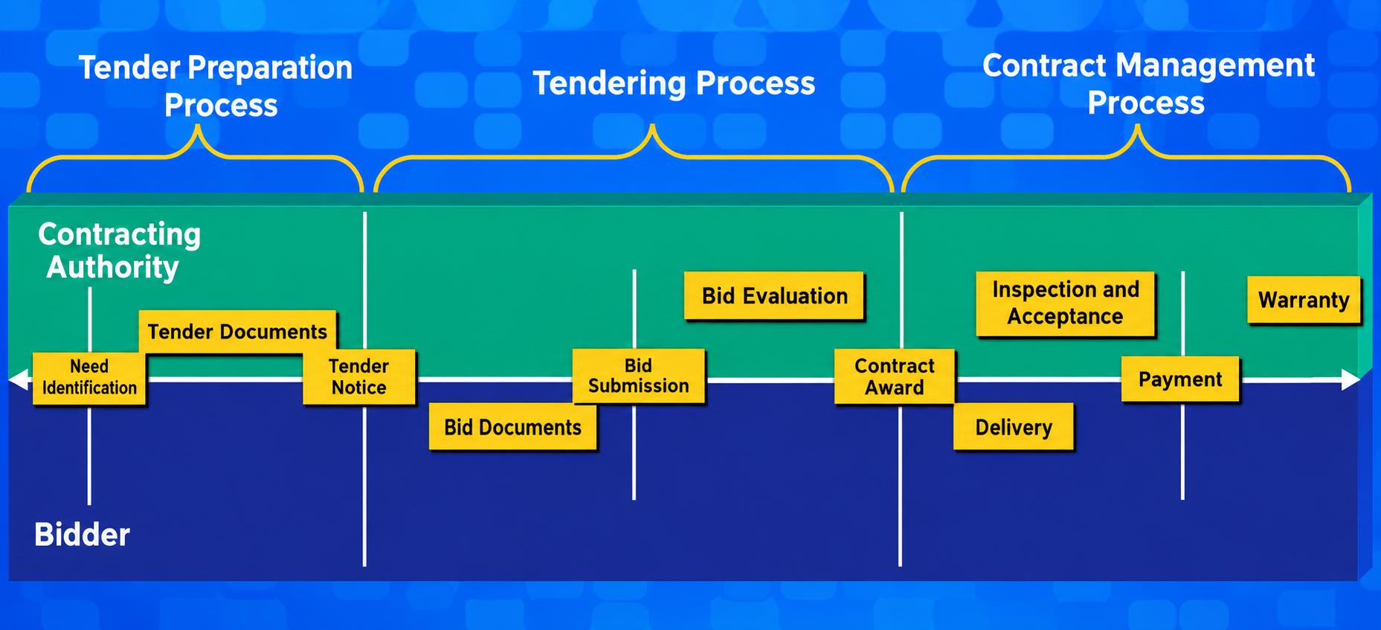
2-Tendering Process
Public Procurement Law No. 4734
It encompasses the processes—conducted in accordance with the procedures and conditions stipulated by law—through which the procurement of goods or services, or the execution of construction works, is awarded to a party selected from among the bidders, concluding with the signing of a contract following the approval of the authorizing official.
Notes:
İşveren Açısından
1-İhtiyacın Ortaya Çıkması >>> Talep İşin ve Bütçesinin (Yaklaşık Maliyet) Belirlenmesi
2- Genel ve Teknik Şartnamelerin Hazırlanması
3- İhale Usulünün Belirlenmesi
4- İsteklilerin Belirlenmesi
5- En İyi Teklifin Belirlenmesi (Mali ve Teknik Değerlendirme)
Yüklenici Açısından
1- İhale Dokümanlarının Temini
2- Risklerin Tespiti
3- Teklif Dosyasının Hazırlanması

Slide 5
2-Tendering Process
Selection of the Tendering Method
Principal Tendering Procedures
Open Tendering
  Selective Tendering
  Negotiated Tendering

Slide 6
Open Tender
Advantages
The open tender procedure allows all contractors interested in the tender to participate in the tender.
The open tender procedure ensures competition.
Disadvantages
While many contractors submit bids for a tender, only one can be successful. Consequently, the probability of a construction firm winning the tender may be low.
If a contract for a public project is not awarded to the bidder who submitted the lowest offer, public trust may be shaken. However, there are times when the contract is not awarded to the lowest bidder because that contractor’s reputation is poor.
It can be difficult for a project owner to decline a bid they perceive as the best or most cost-effective. It is not uncommon for a contractor who submits an excessively low bid to go bankrupt. For the project owner, this can result in the work taking longer to complete and incurring higher overall costs.

Slide 7
Selective Tendering
Procedure in which bidders invited by the administration as a result of the pre-qualification evaluation can submit bids
The nature of the work;
  Expertise,
  Advanced Technology
  if it is required, it is carried out according to this procedure.

Slide 8
Selective Tendering
Article 20 of the Public Procurement Law (KİK):
Pre-qualification notice:
  A pre-qualification notice is issued, allowing candidates at least 25 days to prepare their applications.
Pre-qualification assessment:
  Those who fail to meet the specified minimum qualification requirements are not considered qualified..
    The reasons for being deemed insufficient are communicated in writing..
  All candidates deemed qualified are granted at least 45 days to prepare their proposals..
    An invitation to tender is sent to these candidates.
Cancellation of a Tender Under the Procedure of Tendering Among Specified Bidders
  If the number of candidates who can be invited to the tender is less than 5, or
  If the number of bidders submitting a proposal is less than 3, the tender shall be cancelled.

Slide 9
Selective Tendering
Advantages
Since qualified contractors are invited to the tender, the bid offering the lowest price may also be accepted.
Disadvantages
Care should be taken to avoid acting subjectively when adding or removing company names from a given list.
Tender offer prices may be higher than those in open tender procedure. However, it should be considered that this increase may reflect better management ensuring work deadlines and better quality workmanship.
If the composition of the firm list is not adjusted for each individual contract, "firm contamination" may occur.

Slide 10
Negotiated Tendering
Situations in Which the Negotiated Procedure Is Used
Failure to receive any bids following a tender process conducted via the open procedure or the restricted procedure (tendering among a specific number of bidders),
The necessity of conducting a tender on an urgent basis due to the occurrence of sudden and unexpected events—such as natural disasters, epidemics, or situations posing a risk of loss of life or property—that could not have been foreseen by the administration,
The necessity of conducting the tender on an urgent basis due to the emergence of specific circumstances related to defense and security,
The tender being of a nature that requires a research and development process and does not involve mass production,
The inability to define the technical and financial specifications with the necessary clarity, due to the unique nature and complexity of the goods, services, or construction works that are the subject of the tender..

Slide 11
Negotiated Tendering
Procedures for the Negotiated Procedure
Bidders shall first submit their initial proposals—which do not include pricing—covering aspects such as the technical details of the work subject to the tender and the methods for its execution.
The tender commission discusses with each bidder the methods and solutions that will best meet the administration's needs.
Once the terms have been clarified through technical discussions, the bidders capable of meeting these requirements are requested to submit their final proposals—which must include their price offers—based on the revised and clarified technical specifications.

Slide 12
Negotiated Tendering
These are tenders conducted in two stages, in which the contracting authority discusses the technical details of the project, the methods of execution, and—in certain cases—the price with the bidders.
Advantages
The contractor may offer advice to the architect during the design development process.
The contractor can begin material procurement and scheduling at an early stage, which can help streamline production.
Disadvantages
There is a possibility that the cost of the work may be higher than it would be under an open tender procedure.

Slide 13
Design Competitions
Whenever the administrations deem it necessary;
for the purpose of obtaining a plan or design project related to
    architecture,
    landscape architecture,
    engineering,
    urban design projects,
    city and regional planning, and
    works of fine art
    In accordance with the procedures and principles to be established in the relevant legislation, it may organize competitions—with or without prizes—by issuing a public notice designed to ensure fair competition, with the entries to be evaluated by a jury.
*** REGULATION ON COMPETITIONS FOR ARCHITECTURE, LANDSCAPE ARCHITECTURE, ENGINEERING, URBAN DESIGN PROJECTS, URBAN AND REGIONAL PLANNING, AND WORKS OF FINE ART ***

Slide 14
Design Competitions
Advantages
A plan or design project selected through a competition may be more aesthetic than those not chosen in this manner.
The design can fully meet the client's expectations.
Since the client is well-informed about the design, they can oversee the project more effectively.
The client has the opportunity to select the most suitable option from among various projects.
Because firms submit their price bids based on the selected design, it becomes easier for the client to compare costs.
Since firms participating in the tender do not incur separate design costs, the overall design-related expenses remain lower.
Disadvantages
Because it is a two-stage tender, the cost is high, and completing both stages takes time.
For the design firm that loses the competition, overhead expenses increase, leading to higher costs.

Slide 15
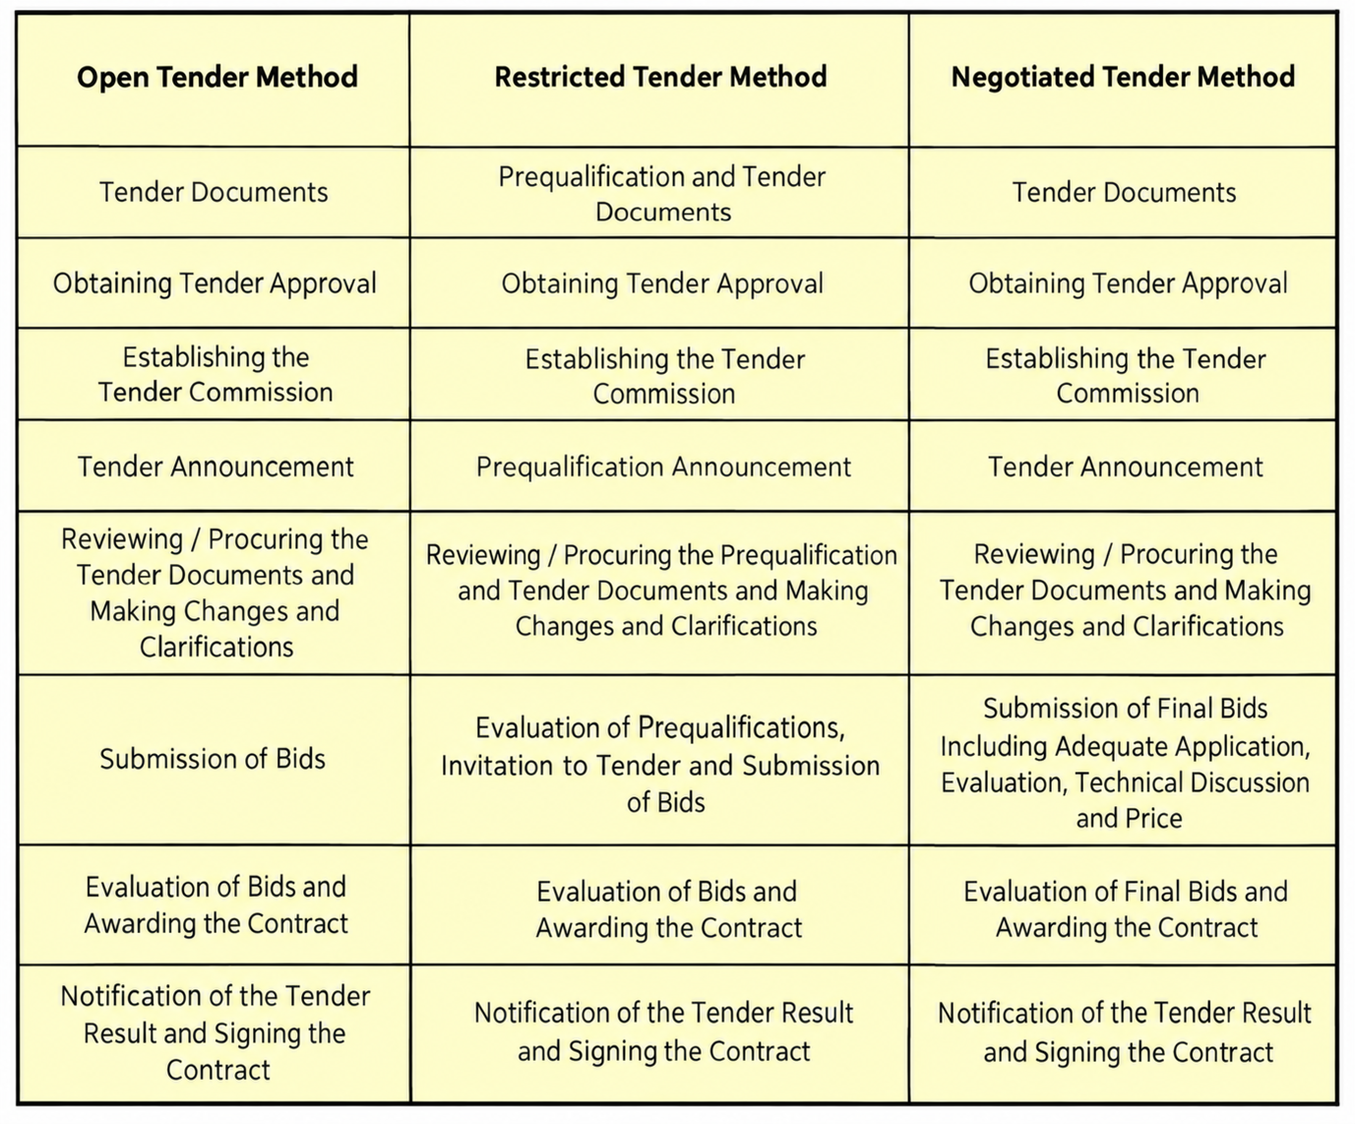

Slide 16
2-Tender Process
Tender Announcement
The project owner provides key information regarding the work covered by the contract, issues an announcement through local, national, or technical media outlets, and invites interested contractors to consult the relevant contract documents.
  http://www.ihale.gov.tr
  EKAP (EPPP) >>> By the Public Procurement Authority and numerous other public institutions and organizations, via an electronic medium (Electronic Public Procurement Platform) "EKAP (EPPP)" and it is a tender tracking system that allows you to access tender announcements—both those that are publicly advertised and those that are not—as well as the tender specifications, directly from the institutions' own websites.
  Newspaper tender notices

Slide 17
2-Tender Process
Formation of the Tender Commission
Establishment: It is established by the contracting authority within a maximum of 3 days following the date of the initial tender notice or invitation.
Structure: It consists of an odd number of members, at least 5 in total, including one chairperson. Among the members, there must be at least 2 subject-matter experts and 1 personnel responsible for accounting/financial affairs. Alternate members are also designated alongside full members.
Duties: Conducts evaluations and decision-making processes during the tendering procedure.
Decision-Making: The commission convenes with full attendance and decisions are taken by majority vote. Members cannot abstain.
Liability: Members are responsible for their votes and decisions. Members casting a dissenting vote must state their grounds in the decision and sign it.
Documentation: Commission decisions and minutes are signed, stating the name, surname, and official titles of the chairperson and members.

Slide 18
2-Tender Process
Tender File
While the number and nature of the documents to be included in a tender file vary depending on the work to be performed, every tender file must contain at least the following documents.
  Projects (architectural, structural, mechanical/electrical installations, insulation, landscaping, etc.)
  Administrative specifications
  Technical specifications
  General Specifications for Construction Works
  Draft contract
  Standard forms (templates for the Letter of Bid for Unit Price Contracts, Schedule of Unit Prices, Joint Venture Declaration, Provisional Letter of Guarantee, Performance Letter of Guarantee, etc.)
  Summary of quantities or summary of cost estimates (bill of quantities/cost estimate summary)
  Information and documents regarding the site conditions—such as soil characteristics, topography, and accessibility—where the construction is to take place.

Slide 19
2-Tender Process
Submission of Proposals
Preparation of the proposal
The proposal letter and all required documents are prepared.
If requested, a bid bond (provisional guarantee) is also submitted as part of the proposal.
The format and submission conditions specified in the tender documents must be followed.
2. Submission of the proposal
The proposal must be submitted by the specified deadline (date and time).
Proposals received after the deadline will not be accepted and will be returned unopened.
3. Double-envelope system
Envelope A → Technical Proposal
Envelope B → Financial Proposal
Both envelopes shall be placed inside an outer envelope, sealed/closed.
The technical proposal must not contain any information regarding price.
4. Validity period of the offer
The tender document specifies the period for which bids remain valid.
Where necessary, this period may be extended with the consent of the bidder.
⚠️ Important : Failure to comply with submission requirements, improper sealing of envelopes, or the inclusion of pricing information in the technical proposal may result in the rejection of the proposal.

Slide 20
2-Tender Process
Evaluation of Proposals
⚠️ The objective of the tender process is not merely to select the lowest-priced bid, but to identify the most suitable contractor capable of meeting the project requirements and fulfilling the terms of the contract.
The bid evaluation process is generally carried out in two stages:
1. Compliance & Eligibility
Determination of those ineligible to participate in the tender
Technical competence
Economic and financial competence
Experience in similar works
Sufficiency of personnel, equipment, and resources
2. Bid Evaluation
Evaluation of the bid price
Evaluation of the technical proposal
Evaluation of the work schedule and methodology
Evaluation of risks and bid conditions
Consideration of quality, duration, and other criteria, where necessary

Slide 21
2-Tender Process
Evaluation of Proposals
Depending on the evaluation criteria specified in the tender documentation, different approaches may be used:
1. Lowest Price
The lowest-priced bid is selected from among technically and administratively compliant bids. This approach is particularly suitable for standard works with clearly defined scopes and technical requirements.
Risk: Insufficient consideration of performance factors other than price.
2. Most Economically Advantageous Tender / Best Value
In addition to price, quality, technical competence, duration, experience, methodology, and other performance criteria are evaluated together.
Scores may be assigned by weighting price and technical criteria.
This approach may be preferred for more complex and technically diverse projects.
3. Two-Stage Evaluation
Technical qualifications / technical proposals are evaluated first.
Financial proposals are then evaluated among bids meeting the specified criteria.
This approach may be used particularly for projects with complex scopes or technical solutions.

Slide 22
2- Tender Process
Bid Evaluation
Basic principle:
Lowest bid ≠ Always the most advantageous bid

Slide 23
2- Tender Process
Contract Award
Invitation to Sign the Contract
The successful bidder is invited to sign the contract.
The invitation specifies where and within what period the contract must be signed, as well as the obligations to be fulfilled.
Where required, submission of the performance guarantee and other documents is requested.
Once the contract is signed within the specified period, the tender process is completed and the contract implementation phase begins.

Slide 24
3-Contract Drafting Process
Preparation of the draft text (draft contract)
  Ambiguous wording and uncertainties (!)
  Contra Proferentem:
  An ambiguous clause is interpreted against the party that drafted it.
Sharing the draft text with the parties
  Internal circulation (a text involving all relevant personnel, including contracts, legal, occupational safety, finance and quality, should be developed with the engineer’s approval)

Slide 25
Construction Contracts
Contents
Agreement (Contract Text): Identifies the contractor and owner, the time allowed for completion, the method of payment, and the structure to be built.
General Conditions of Contract
Special and Supplementary Conditions
Technical Specifications: Define the required quality of construction materials, equipment, and workmanship.
Drawings / Plans

Slide 26
Key Contractual Provisions
Parties to the Contract
Definitions
Subject of the Contract
Contract Type and Price
Payment Method and Schedule
Contract Duration
Rights and Responsibilities of the Parties
Warranty Period
Provisional Acceptance / Final Acceptance / Approval Procedures
Penalties and Liabilities
Force Majeure
Termination Provisions
Guarantees
Insurance
Confidentiality / Non-Disclosure Obligations
Variation Conditions
Dispute Resolution Clause

Slide 27
Contract Drafting
Key Considerations
The language of the contract must be clear and precise, avoiding ambiguous wording.
Inconsistencies between contract documents should be avoided, and a document precedence clause should be included to define their order of priority.
Repetition within the contract should be avoided. A provision stated in one section should not be repeated elsewhere; instead, the original provision should be referenced.
The contract price and duration, purpose (scope of work), delays, sanctions, force majeure, and allocation of risks between the parties should be clearly specified.
The commencement date and conditions must be clearly stated in the contract.
A dispute resolution clause should be included to address potential claims and disputes between the parties.
The contract must be signed by persons authorized to execute it.

Slide 28
4- Contract Negotiations
The process of mutually reviewing and clarifying contract terms with the selected bidder before signing the contract.
Main objectives:
Assess the suitability of the bid and contract terms
Clarify the rights, responsibilities, and obligations of the parties
Clarify provisions that may cause ambiguity or differing interpretations
Finalize scope, duration, price, and payment terms
Ensure appropriate allocation of risks between the parties
Negotiate contractual provisions where necessary
Key negotiable issues: Scope • Price • Duration • Payment • Risk allocation • Variations • Delays and penalties • Guarantees • Termination conditions • Dispute resolution

Slide 29
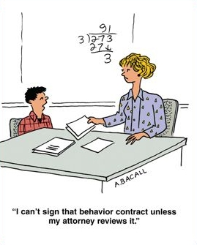

5- Contract Signing and Distribution
Signing the Contract
  Signing Authority (!)
Distribution of contract copies to relevant departments
  Contracts are confidential documents.
  Disclosure to third parties may result in legal penalties.

Slide 30
6- Contract Administration
Mobilization & Demobilization
Monitoring Work Processes (Milestones & Responsibility Matrix)
Monitoring Quality Practices
Monitoring Occupational Health and Safety Practices
Partial Acceptance - Provisional Acceptance - Final Acceptance
Progress Payment Calculations and Payments
Management of Changes / Revisions
Performance Evaluations
Claims
Return of Guarantees
Warranty Procedures (Repair, Maintenance, Replacement)
Dispute Resolution
Contract Closeout

Slide 31
6- Contract Administration
Change Orders
The process of managing changes in the scope, quantities, nature, duration, or execution conditions of the work after contract signing, in accordance with the contract.
Main reasons for changes:
Owner requests
Design changes or errors
Unforeseen site conditions
Changes in legislation or standards
Increases / decreases in work quantities
Technical requirements arising during execution
Change management process:
Identification of change → Impact analysis (cost – time – quality – risk) → Approval of change → Issuance of Change Order / Variation → Implementation and documentation
Basic principle: Changes to the contractual scope must not be implemented without notifying the parties and obtaining the necessary approvals.
Change → Cost + Time + Risk → Potential Claim / Dispute

Slide 32
6- Contract Administration
Payment Process
The payment process covers the measurement, verification, and payment of work performed by the contractor under the contract, in accordance with contractual terms.
Basic payment process:
Execution of work → Measurement and preparation of progress payment → Review and approval by owner / supervision team → Issuance of invoice → Payment in accordance with the contract
Factors affecting payment amounts:
Quantity of work completed
Contract unit prices / lump-sum price
Approved variations
Advance payments and advance recovery deductions
Deductions / retention
Taxes and other statutory deductions
Other contractual deductions from progress payments
Basic principle: Payments must be based on completed and verified work quantities and contractual terms.
Variations → Progress Payment → Payment → Cost Monitoring

Slide 33
6- Contract Administration
Risk Management
Risk Management Process
1. Risk Identification Technical, financial, legal, environmental, schedule, and site risks, etc.
2. Risk Assessment Probability × Impact
3. Risk Allocation Risk should be allocated appropriately to the party best able to manage it.
4. Risk Response
  Avoidance (Avoid)
  Mitigation (Mitigate)
  Transfer / Sharing (Transfer / Share)
  Acceptance (Accept)
5. Monitoring and Updating Risk occurrence and the effectiveness of mitigation measures are monitored.

Slide 34
6- Contract Administration
Risk Management
During contract administration, the aim is to identify and assess risks that may affect project objectives in advance and develop appropriate response strategies.
Clearly defining risks in the contract and allocating them between the parties facilitates the management of subsequent variations, claims, and disputes.
RISK → CHANGE → COST and TIME impacts of change → Reflected in PROGRESS PAYMENT / PAYMENT → If disagreement arises between parties → CLAIM → DISPUTE

Slide 35


